Slide 1
Software Product Management ASSIGNMENT 1 Chouk Connect System (CCS)
Group 5
AMIT NAIK (2022MT93215)
ANAND PRAKASH DUBEY (2022MT93359)
ANANT PATNI (2022MT93238)
ANDRADE PRAKASH PETER MARGARET (2022MT93366)
ANGSHUMAN PAL (2022MT93165)

Slide 2
About
“Chouk Connect” is an application which provide a complete end to end solution for both parties (labors and employer).
It is your one-stop destination for expert local services. Get dozens of trusted professionals near you to take care of all your problem
It is a service provider business that connects service seekers with service providers

Slide 3
Team Intro
AMIT NAIK (2022MT93215)
ANAND PRAKASH DUBEY (2022MT93359)
ANANT PATNI (2022MT93238)
ANDRADE PRAKASH PETER MARGARET (2022MT93366)
ANGSHUMAN PAL (2022MT93165)

Slide 4
Group Discussion link
http://taxila-aws.bits-pilani.ac.in/mod/forum/discuss.php?d=56909

Slide 5
Purpose of the CC System (Goal)
Below are the purpose of CCsystem
This app is very user friendly and available in main languages so it can cover large number of audiences.
User must register themselves as either or the category (Skilled Worker or Employer)
If user is skilled worked, then they must provide their skills and work area preferences and hourly rate and they must update their profile and show case themselves and availability time.
If user is employer, then they must put bidding details and hourly rate and select available skilled workers.
Both users can see available skilled work and available work in given area

Slide 6
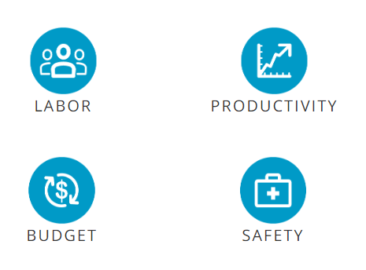
Identify a product opportunity

Slide 7
Identify a product opportunity
Labor: Finding & Keeping the Right Employees
The public perception that professional cleaning is not skilled work has long been pervasive in the cleaning industry. Though this is not true, especially for highly specialized commercial and industrial applications, this perception tends to lead to high employee turnover for cleaning companies. Due to this negative perception, those who apply for open positions may not be the best fit, and those who are a good fit may not want to stay in the position long.
Companies spend a significant amount of time and resources hiring, onboarding, and training their employees. The more turnover a cleaning business experiences, the more costly hiring and training can become. Not to mention, the business can also lose money if they find themselves short-staffed or if they have under-trained staff who are not performing to the customer’s expectations.
Staff can make or break a commercial or industrial cleaning business. If cleaning companies want to reduce hiring expenses while improving the quality of their staff, they need to become adept at hiring the right professionals for the job. This requires cleaning businesses to provide more detailed and accurate job descriptions and perform national background checks as part of the hiring process. Additionally, cleaning companies need to develop more effective interview questions and make sure that their expectations are clearly communicated during the interview process.
It’s important to not only hire effectively but also work to ensure that employee retention is a major focus. Improving employee retention starts with understanding how your company culture impacts employee job satisfaction. Identifying areas for growth and making positive changes to the culture can help ensure that employees are happier and more productive in their workplace, which can lead to lower turnover rates.
Here are just a few ways that cleaning businesses can improve employee retention:
Having a formal recognition system that acknowledges employees who go above and beyond in providing quality service.
Providing the opportunity to complete varied job tasks that keep employees interested and satisfied with their jobs.
Creating a system for collecting employee feedback and making changes based on this feedback for a better work environment.
Investing in new training programs that allow employees to learn new skills and expand their knowledge of the industry.

Slide 8
Identify a product opportunity
Productivity: Improving Cleaning Efficiency
As mentioned earlier, the cleaning industry has seen a major shift in customer expectations when it comes to cleanliness. The trend of cleaning for health forces professional cleaning companies to be more thorough in their processes to provide more effective services. However, if they want to also be profitable, they need to stay productive and efficient. This makes it vital for cleaning companies to find ways to improve their efficiency so that they can remain effective without increasing service turnaround times.
Investing in effective cleaning equipment makes it easier for cleaning companies to boost efficiency without impacting quality. Choosing the right equipment for your cleaning needs is essential for companies that want to improve commercial cleaning productivity. For instance, using machines that have pre-set cleaning options allows your staff to start cleaning right away without wasting time on set-up. This not only improves productivity but can also provide more consistent cleaning results.
In addition to machines with pre-set cleaning options, cleaning companies should also consider investing in equipment that allows employees to get into tight spaces and hard to reach areas. Rather than having the employee get off a machine in the middle of a service visit and switch to a broom or mop, they can use machines that allow for close cleaning, giving them the ability to clean close to equipment, pallets, shelves, racks, and other infrastructure.
Aside from investing in the right equipment to help staff clean more effectively, cleaning companies should also consider what new commercial cleaning technologies and automated systems may improve productivity even further. By automating some cleaning process and investing in technologies like IoT-enabled cleaning equipment, commercial cleaning companies can improve productivity while also boosting visibility and gaining greater control over service consistency.

Slide 9
Identify a product opportunity
Budget: Doing More with Less
For as long as commercial cleaning companies have been in business, cutting costs has been a concern. Like any other industry, the commercial and industrial cleaning industry is impacted by budget concerns. Budgets can limit a business, forcing them to do more with less. As the economy dips and cleaning becomes a luxury service that businesses feel they can cut back on, cleaning companies have to continue to provide quality service with a smaller budget.
While opportunities for conventional growth may be limited, especially during times of economic struggle, commercial cleaning businesses can focus on providing value-added services. Companies can differentiate their offering through niche services and specialized personnel that allow them to provide more types of services as one vendor. As commercial and industrial facilities look for ways to cut their own budgets, they may seek to consolidate vendors, choosing a cleaning company that can offer more than just standard cleaning services.
Another focus when it comes to budget is cost control. Cleaning companies need to analyze their operational costs and look for opportunities to keep costs down without sacrificing quality of service. This may require you to change the way you operate and look past what you already know and are comfortable with to take advantage of new ways to save.
Planned maintenance of cleaning equipment is a simple way to save on operational costs over time. Just like a vehicle needs an oil change, tire rotation, and other basic maintenance services to maintain performance, so does your cleaning equipment. Routine maintenance saves you money in the long run by making sure that your equipment performs effectively with fewer breakdowns. It can even extend the life of your equipment, allowing you to get more life out of the machine before it needs to be replaced.
There are also ways that commercial and industrial cleaning companies can reduce cleaning labor costs without sacrificing quality. One way is by developing a strong training program that teaches staff how to work effectively while also being efficient. The more efficiently your team works, the more services you can provide with fewer people. Another important way to reduce labor costs is by investing in innovative and efficient cleaning technologies that automate some of your cleaning processes and improve productivity. This allows you to do more with fewer people.

Slide 10
Identify a product opportunity
Safety: Protecting Employees and Customers
Yet another challenge that companies in the cleaning industry face is how to improve safety in commercial and industrial facilities. Safety will always be a focus in public areas. From minimizing slip and fall accidents to preventing the spread of disease, cleaning companies play a major role in improving the safety of businesses and industrial buildings.
Slip and fall accidents are one of the most common types of safety issues in commercial buildings and industrial facilities. It is the cleaning staff's responsibility to ensure that any spills are cleaned up properly and signage is placed in areas that are still wet. To ensure that staff is consistent with these practices, cleaning companies need to make preventing slip and fall accidents a part of employee training.
Another safety issue that cleaning companies must contend with is the impact that cleaning processes and products have on the environment within the commercial or industrial facility. For instance, using harsh chemicals that give off a strong odor or equipment that creates noise pollution can impact customers and employees that are in the facility at the time of cleaning. Investing in more efficient cleaning technologies can help reduce both noise pollution and chemical use.
Not only do cleaning companies contribute to the safety of employees and customers in a commercial building or industrial facility, but they also must account for the safety of their own employees. This means providing any safety gear necessary and offering adequate training on how to operate cleaning equipment properly. Using equipment and cleaning solutions that reduce the need for harsh chemicals not only provides a cleaner, healthier environment for the commercial or industrial building but also for the cleaning company's employees who are regularly exposed to these materials.
The U.S. Department of Labor's Occupational Safety and Health Administration (OSHA) provides a list of regulations for cleaning companies regarding maintaining a safe and healthy work environment for cleaning staff. Following these guidelines helps ensure that cleaning staff is taking the right safety precautions to protect themselves while working around industrial cleaning solutions and equipment.

Slide 11
Target Market
People who don’t have the time to clean by themselves
People who don’t like cleaning by themselves
People are not able to clean by themselves
People with health conditions who need professional-grade cleaning
Businesses that need cleaning services to create a good impression
Businesses that need cleaning services to comply with regulations

Slide 12
Pain points
Longer Hours, Shorter Cleaning Window
Don’t tell Dolly, but 8 to 6 has replaced 9 to 5 as the norm for many companies, and some would still count that as a short day, as employees in a variety of industries are working longer hours to achieve more demanding targets. Earlier starts and later finishes are great for business performance, but they reduce the available window to have facilities professionally cleaned. This is even more of an issue for offices spaces that provide hot desking. Multiple people sharing the same desk spaces can be prone to working unusual hours, and, be honest, would you leave a temporary desk as tidy as your own?
Heavier Traffic
Businesses, such as airports, train stations and schools regularly receive heavy foot traffic, resulting in a marathon maintenance effort to avoid litter, dirty floors and unclean toilets. Similarly, as a business grows, heavier foot traffic from both customers and staff leads to similar cleaning challenges. Having a cleaner standing by to clean any mess immediately is unlikely to be the most logical or cost-effective option. Therefore, analysing factors such as peak business times, and quieter non-peak times, is vital when creating an efficient cleaning schedule.
Cost Cutting
As businesses look for ways to improve efficiency and increase revenue in search of growth, Facilities Managers are consistently asked to meet unrealistic goals. For example, an employee paid the minimum is likely to move on at first available opportunity. A higher staff turnover will mean higher costs on areas such as training, including in the cleaning and hygiene areas of the company. Additionally, attempts to cut costs on specialist cleaning equipment can prove a false economy when cleaning standards decline, and times increase.
Increased Safety Standards
Increased safety standards are extremely beneficial to society as a whole. Customers receive a safer and cleaner experience, and businesses owners are far less likely to suffer accidents or issues on their premises. However, every new piece of safety standard policy can put a strain on Facilities Managers, as they may have to invest in new equipment, completely reorganise company processes and even retrain staff to ensure new standards are upheld.

Slide 13
Interview Survey Questions for Customer
How important to you that labour should be skilled?
Would you pay bit extra to get skilled & certified worker?
How likely are you to choose the worker who is skilled and provide good service but with bit higher price at market level?
How likely are you to choose the worker where you must do the go pick and drop?
Would you prefer the worker who provide materials as well with some extra expense?
Note - Option for above questions are as below -
Strongly Agree
Agree
Neutral
Disagree
Strongly Disagree
Survey URL - https://forms.gle/g3SyB7wtXF1HwKno8

Slide 14
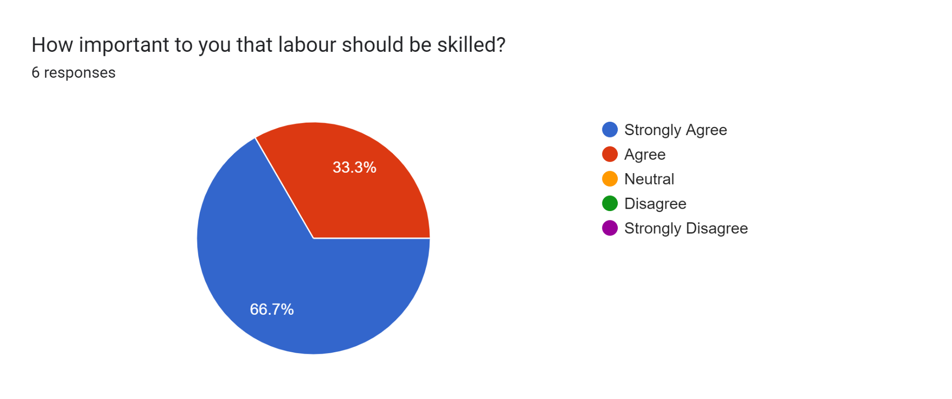
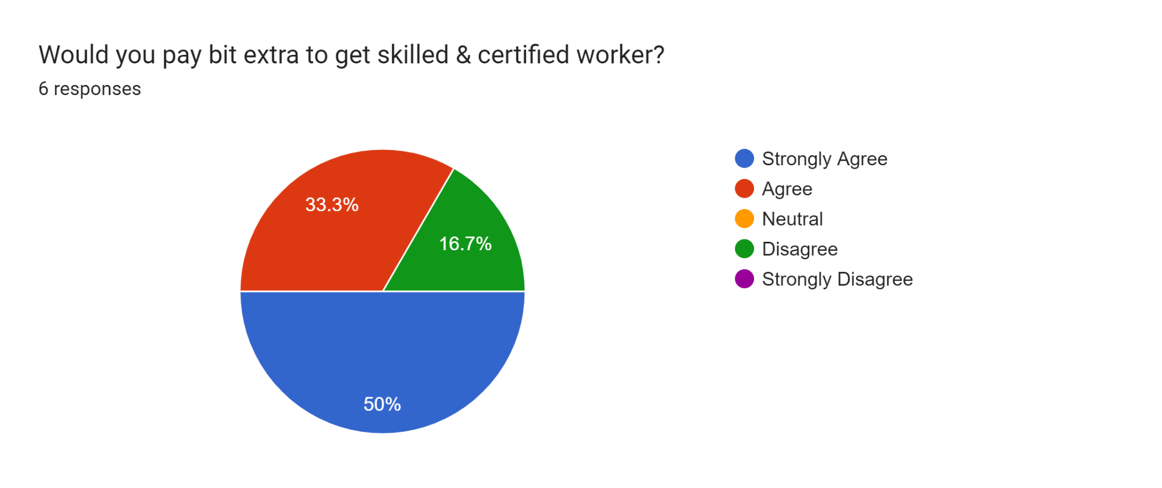
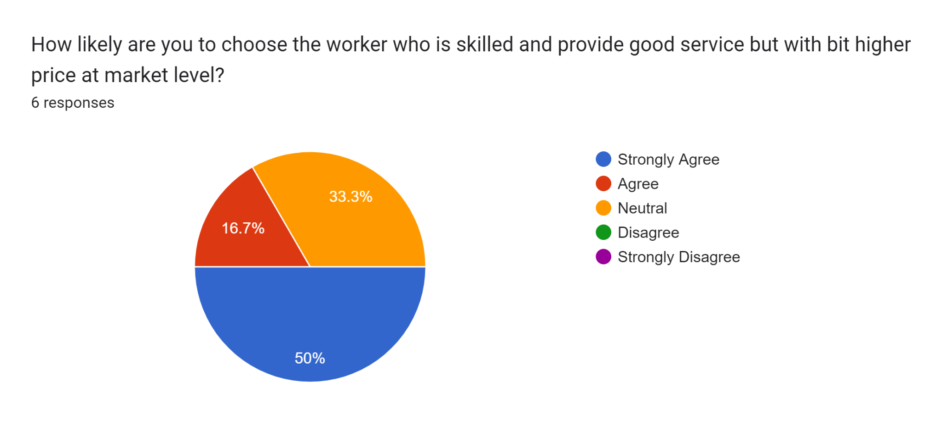
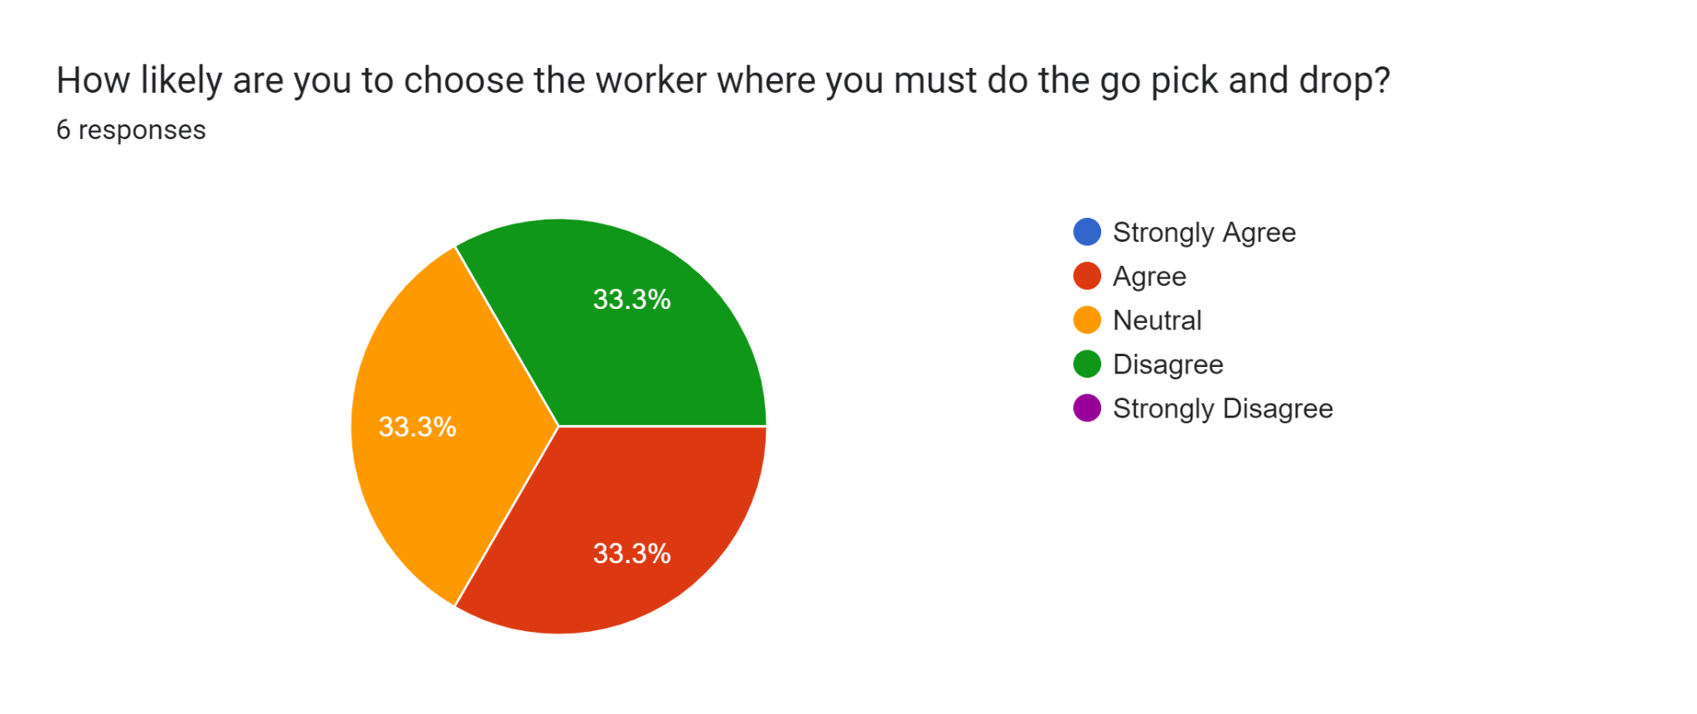
Interview Survey Questions for Customer - Responses

Slide 15
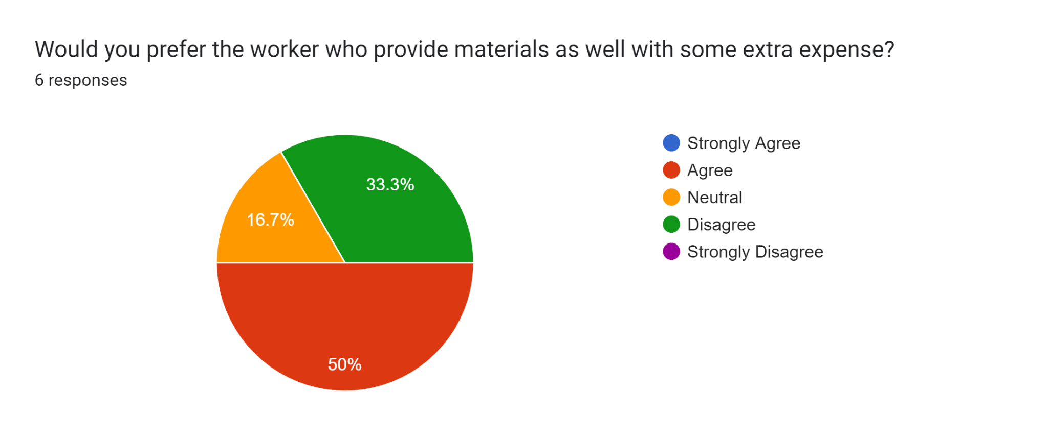
Interview Survey Questions for Customer - Responses (Cont…)

Slide 16
Value Proposition
Final product will create an app-based and web-based system designed to connect customer and professional staff. Create job opportunity for low end professional or uneducated people
Value Proposition:
This app is very user friendly and available in main languages so it can cover large number of audiences.
User must register themselves as either or the category (Skilled Worker or Employer)
If user is skilled worked, then they must provide their skills and work area preferences and hourly rate and they must update their profile and show case themselves and availability time.
If user is employer, then they must put bidding details and hourly rate and select available skilled workers.
Both users can see available skilled work and available work in given area

Slide 17
Story Map
User Activities
User Account
Orders & Payments
Tracking & Feedback
Customer Support & User Profile
Release 1 Minimum Viable Product
Registration
(Customers & Chefs)
Menu, Search, Cart
Track Labors
Update Profile
Login/Password
Payment
UPI, Card, COD
Feedback
Support: e-mail, phone, chat
Release 2
User Booking Services
Labor Status
No. of Orders Customer done
AI Bots for Support
Confirm Date/Time
Addon Page/Additional Service page
Provide work done Images by labor
Release 3 Additional Features
Filter options as per rating
Rewards points
Real time tracking
Labor’s Success stories

Slide 18
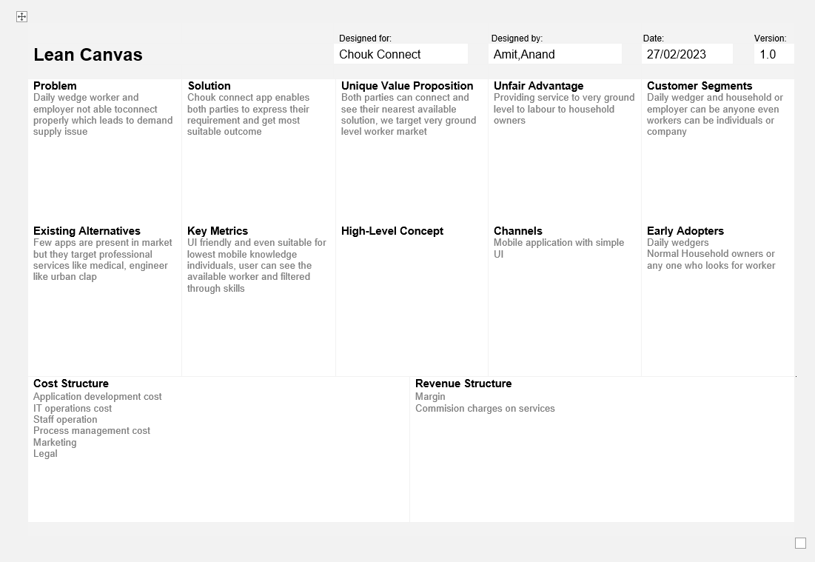
Canvas

Slide 19
Key learning -AMIT NAIK (2022MT93215)
Market research and geo location is very important to focus on any product
High vision and product roadmap with iterative releases (sprint planning) with phases and new feature to be introduce
Time - When to enter the market, marketing and launch plans should be ready
Right technology to implement, good presentation and easy to use of application is very important to get customer
Understanding problem statement of customer needs and giving right solution with right time
Collecting customer feedback is very important to improve the product

Slide 20
Key learning -ANAND PRAKASH DUBEY (2022MT93359)
Start Canvas - To visual map for founders who want to judge their new business ideas strengths and weaknesses.
Story Map - A visual method in which teams outline the work requirements that achieve the best end-user experience.
Refactoring product idea through customer interview and feedback
Estimating about product initial cost structure and revenue structure at bootstrap level
Identifying problem and providing solution on real life based condition.

Slide 21
Key learning -ANANT PATNI (2022MT93238)
Got to learn about how product-market fit requires constant iteration and experimentation as well as testing your hypothesis.
Got familiar with story map implementation
Learned about how target customers can be reached and information used from them to ensure the product is being correctly designed.
Learned about how value proposition can be defined.
Got to know about how can target customer be reached out for any inputs.

